Slide 1
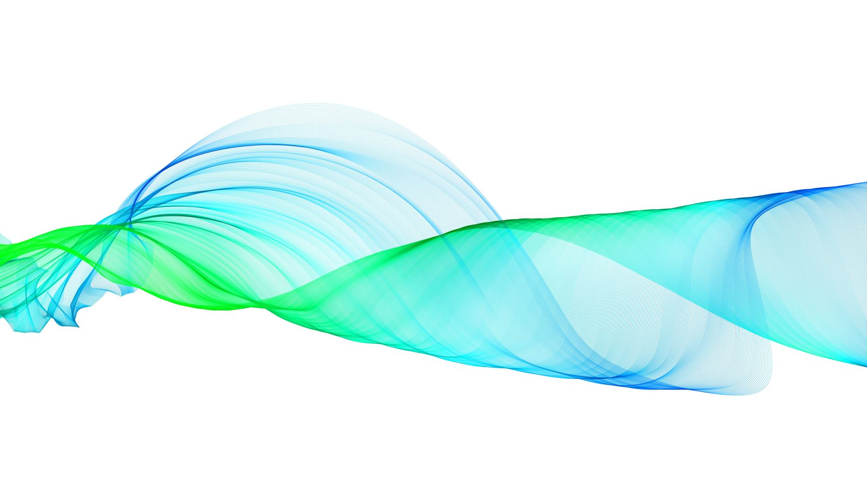
Image Compression

Slide 2
Salma Mohamed 2017/11570
Alaa Yehia 2017/09041
Abanoub George 2017/03340
Marc Ashraf 2017/13199

Slide 3
Problem Statement
Image compression is an application of data compression that encodes the original image with few bits. At its core, image compression is when you remove or group together certain parts of an image file in order to reduce its size.
And when image compression happens there is a concequences to this which are :
Loss of data
Noise
There are two kinds of image compression methods loseless and lossy.In our situation our mehod is loseless as we're using huffman algorithm.

Slide 4
Dataset Images

Slide 5
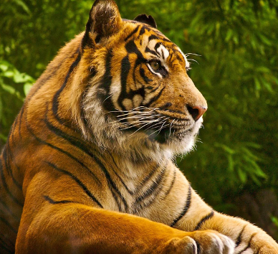
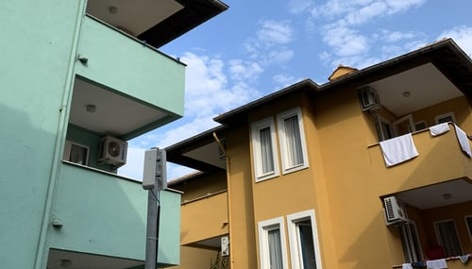


Slide 6

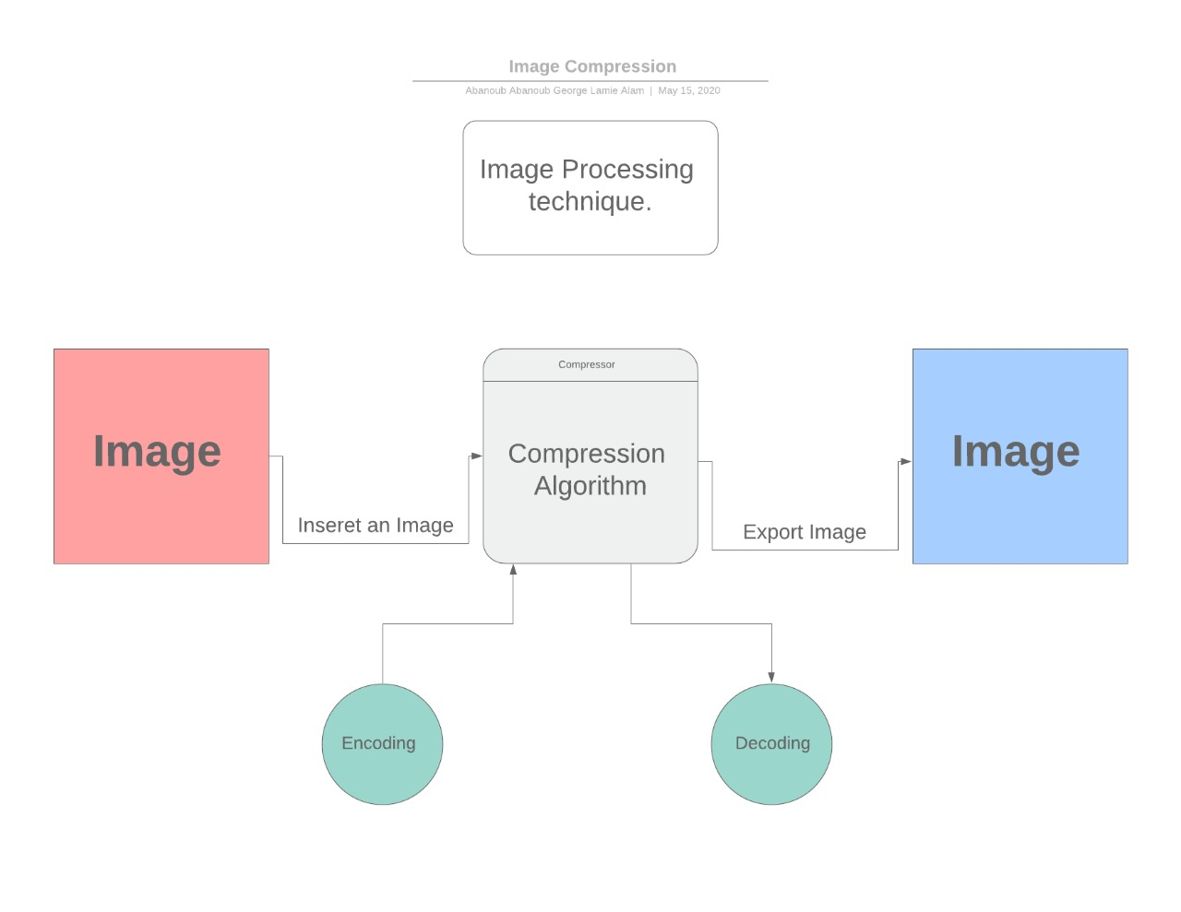
Block Diagram

Slide 7
Algorithm used
In our image compression project , we used Huffman Algorithm .Huffman coding is a lossless data compression technique. Huffman coding is based on the frequency of occurrence of a data item i.e. pixel in images.
Huffman coding can be used to compress all sorts of data.

Slide 8
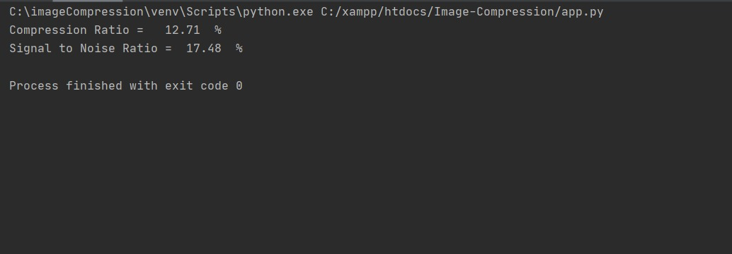
Results

Slide 9
Thank you

